Slide 1
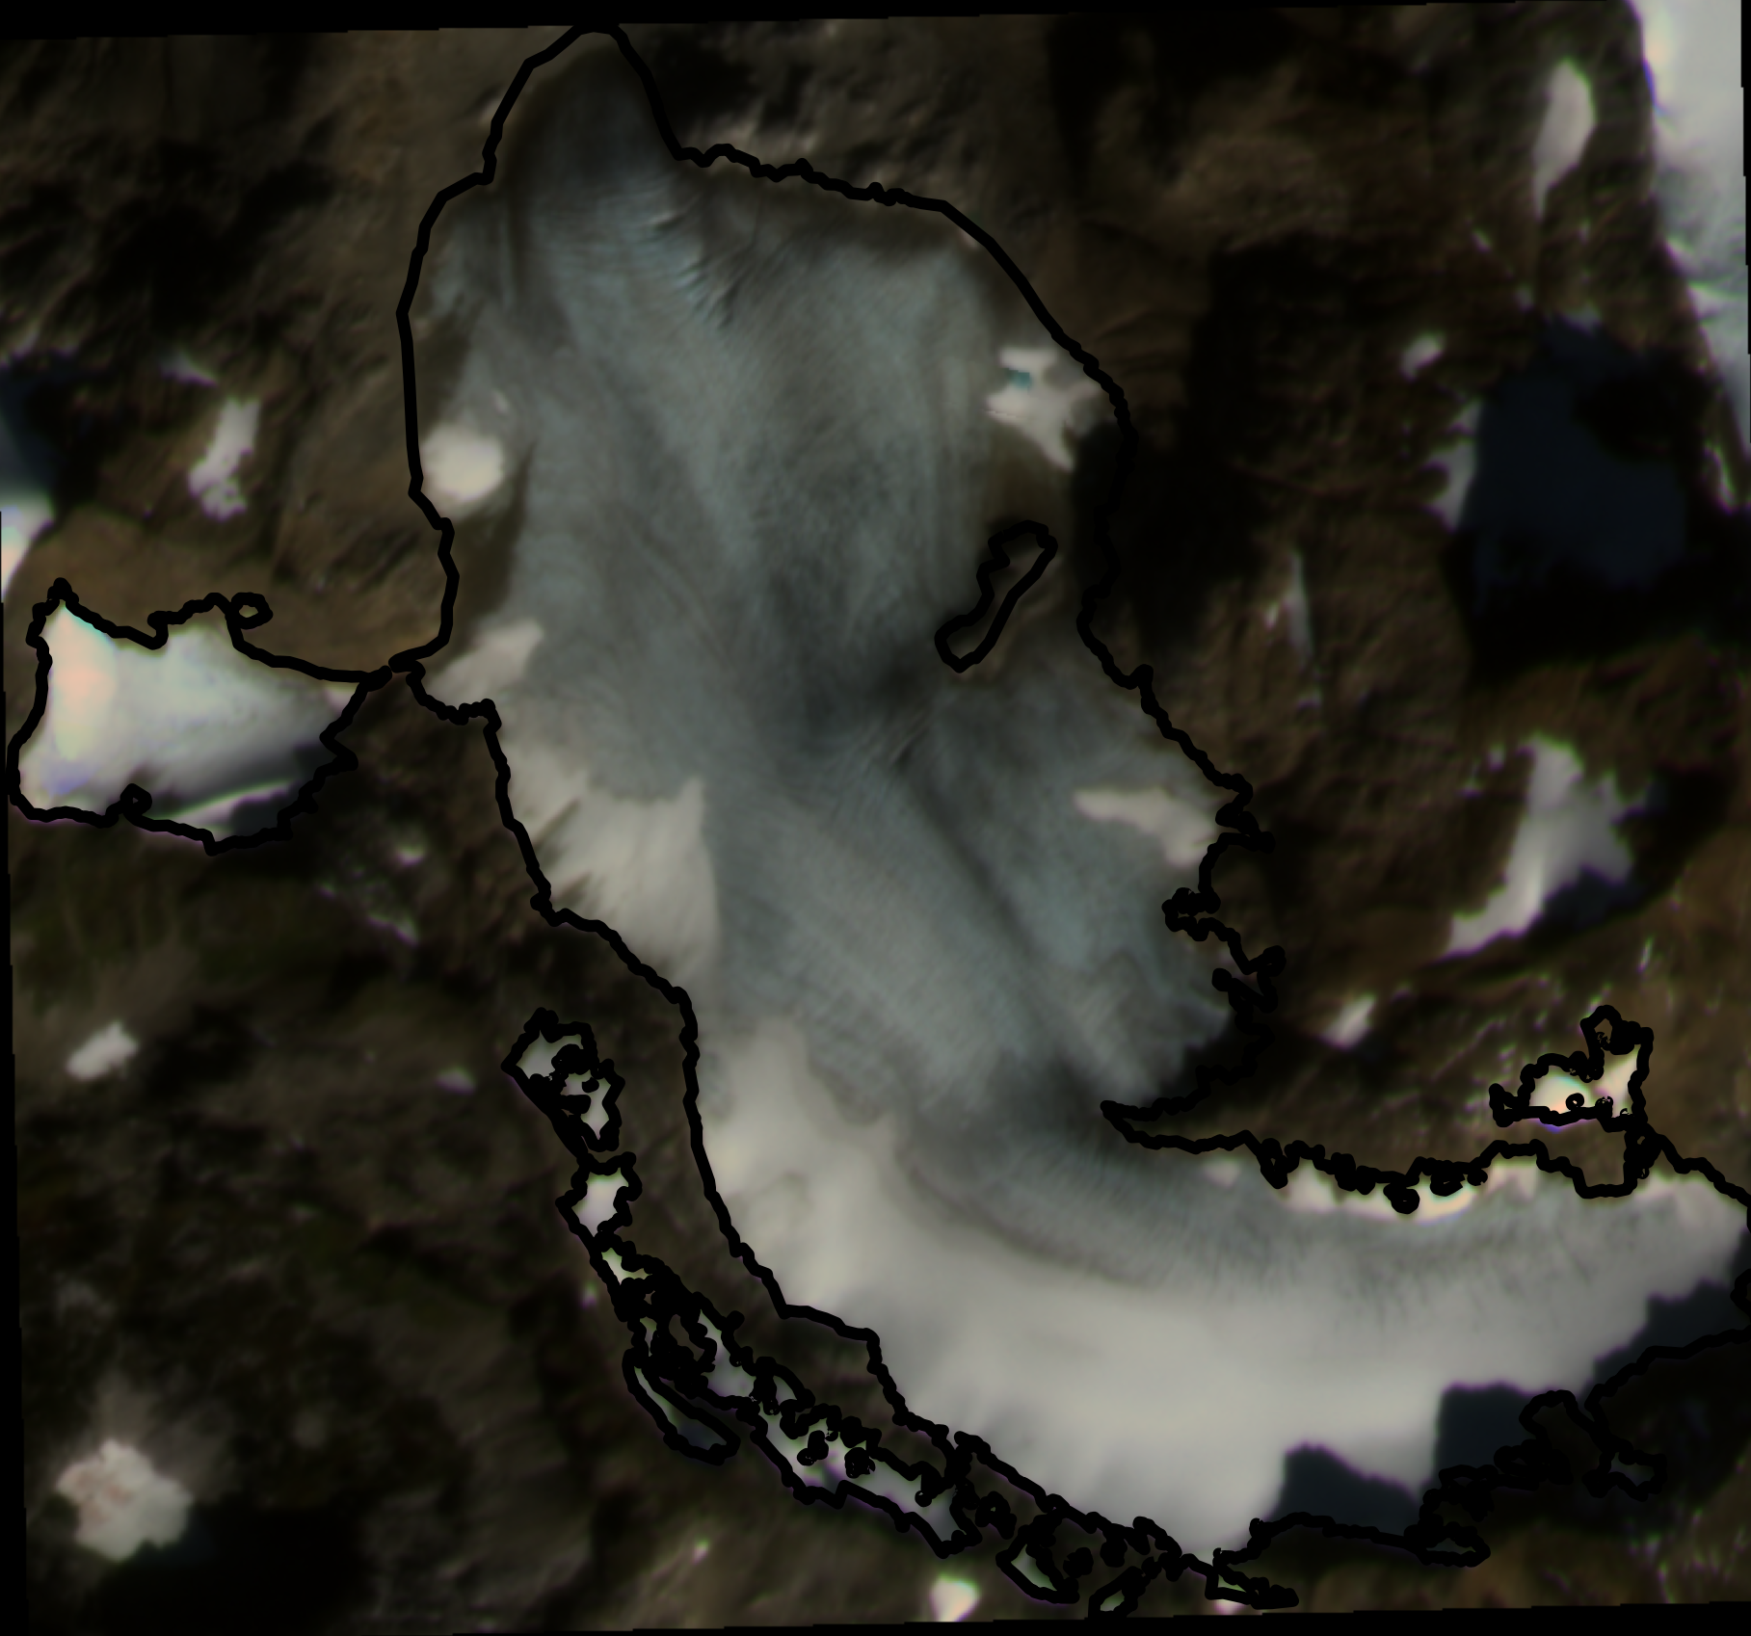
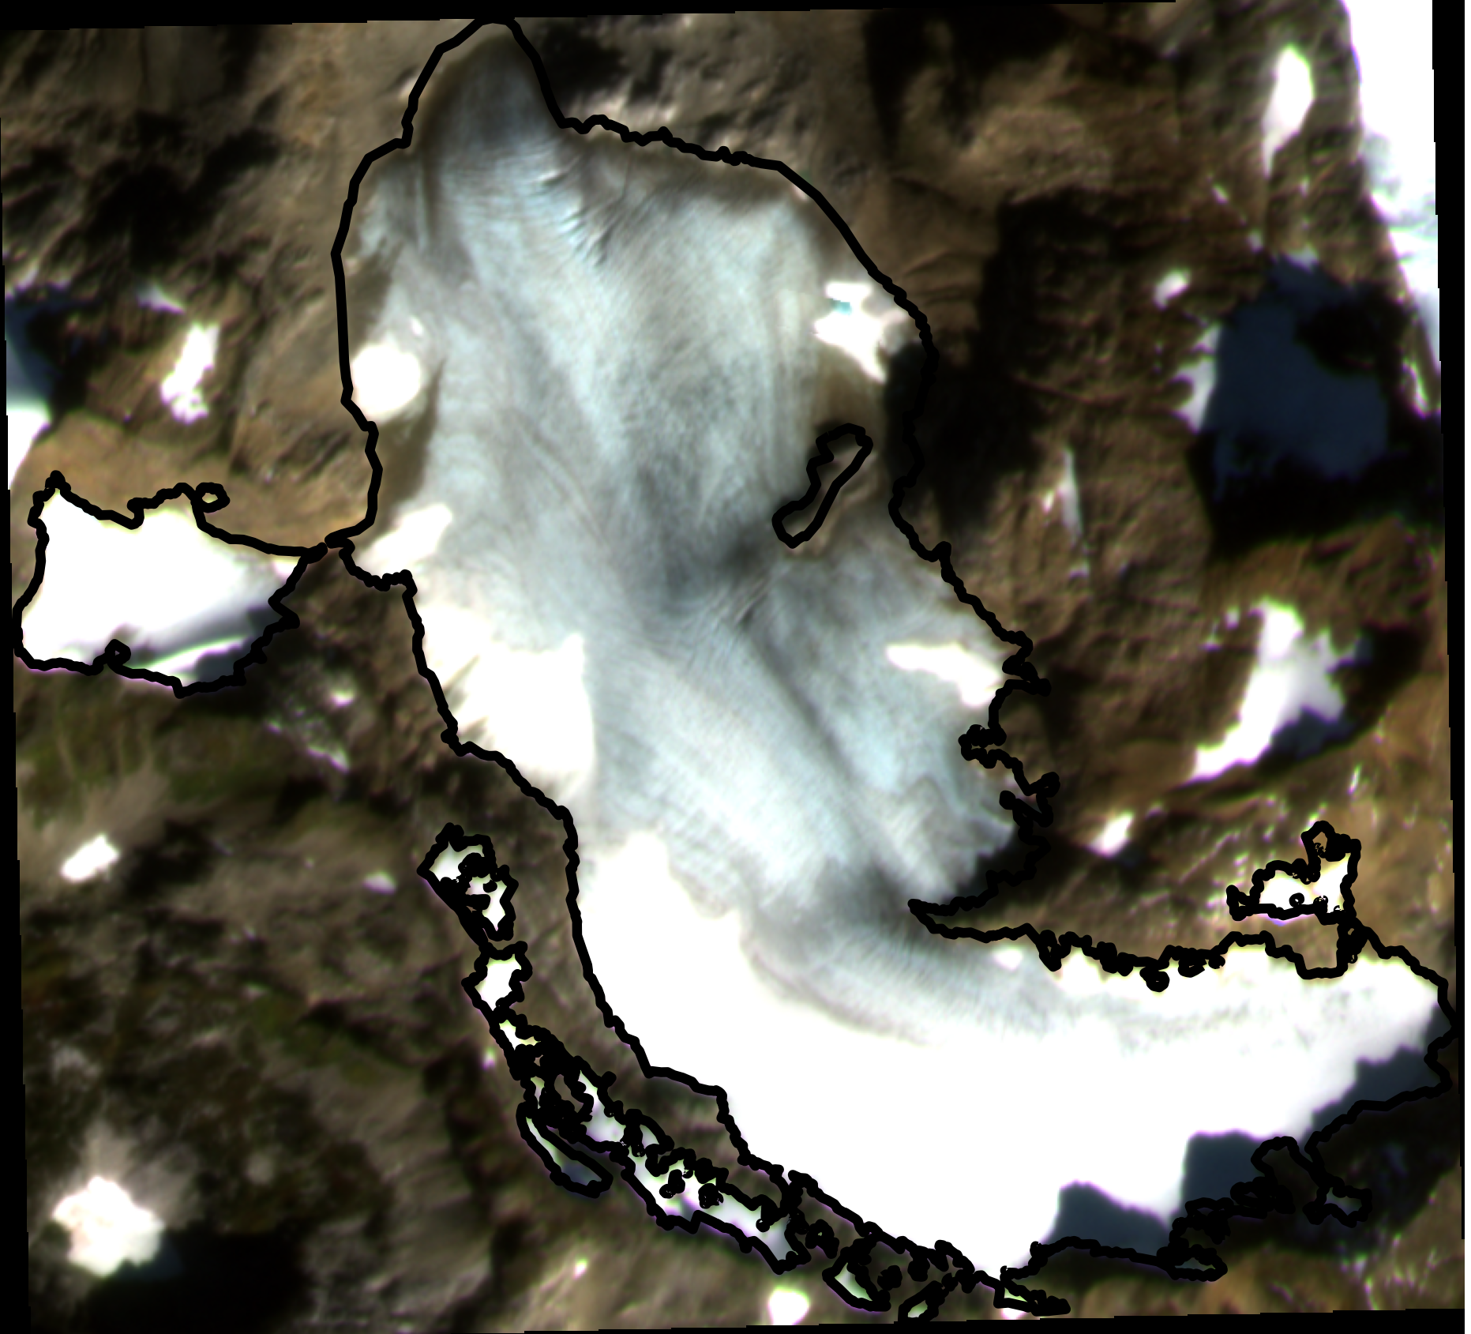
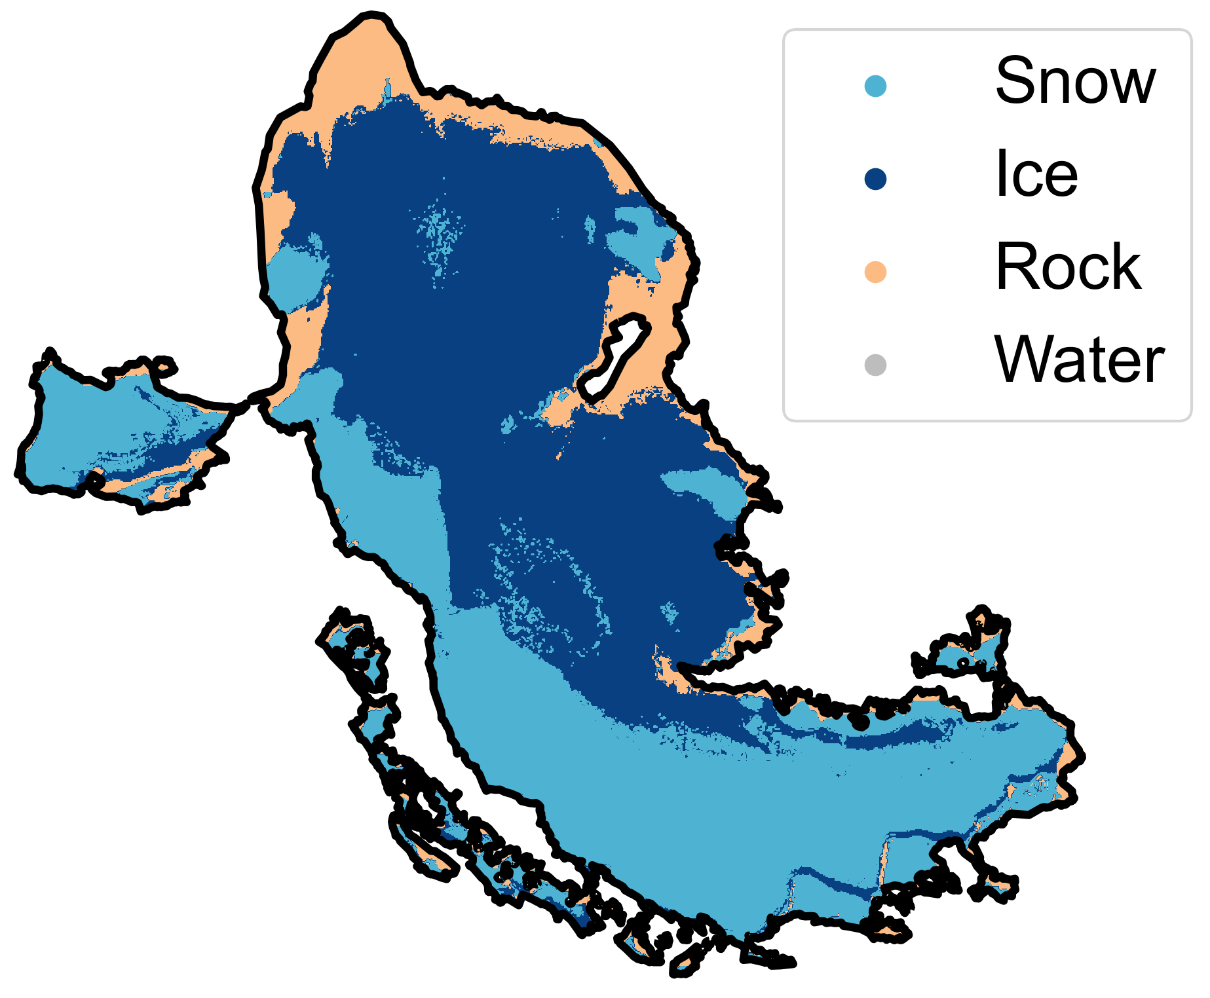
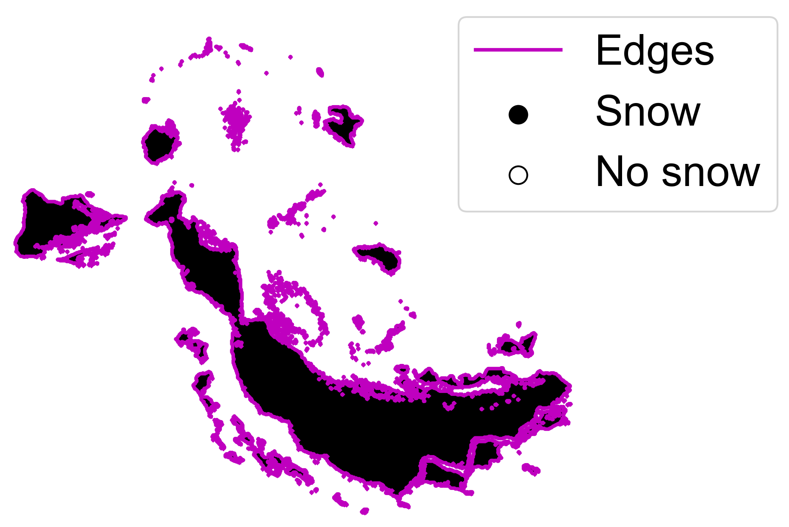
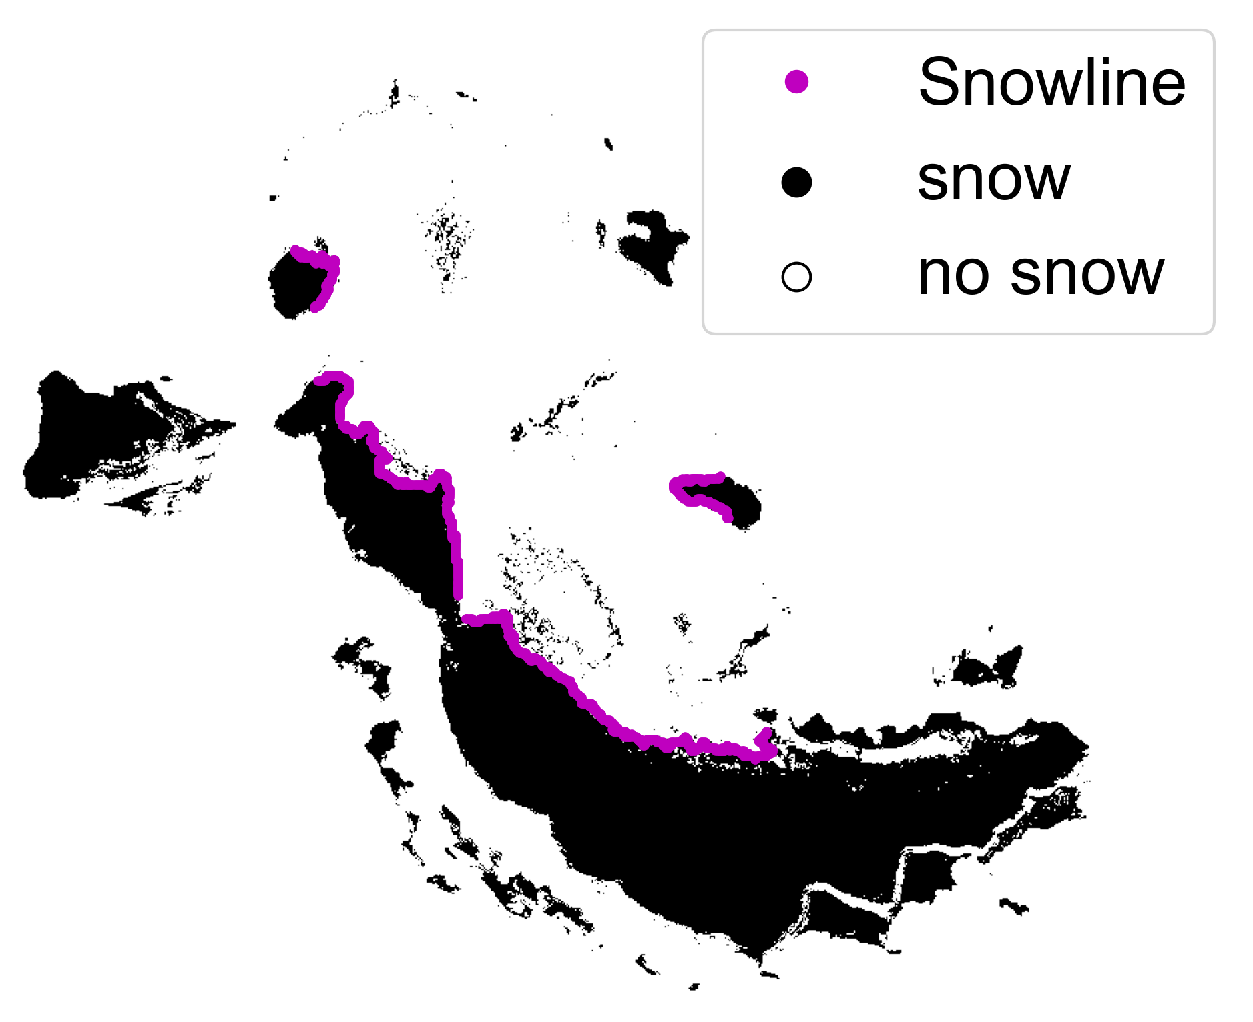
1. PRE-PROCESS
Landsat 8/9 OLI
2. CLASSIFY
PlanetScope 4-band
Sentinel-2 MSI
Filter clouds and cloud shadows
Adjust radiometry
3. IDENTIFY SNOWLINES
Mosaic images captured same day
Pre-trained Landsat classifier
Area of Interest
Classify image collections
Create binary snow image
Identify edges
Filter edges, identify snowline(s)
Digital Elevation Model
Extract snow-covered elevations

